Slide 1
Adversarial Physics.
Design Masterclass.
Ubisoft.
Samuel Cook and Will Terry.

Slide 2
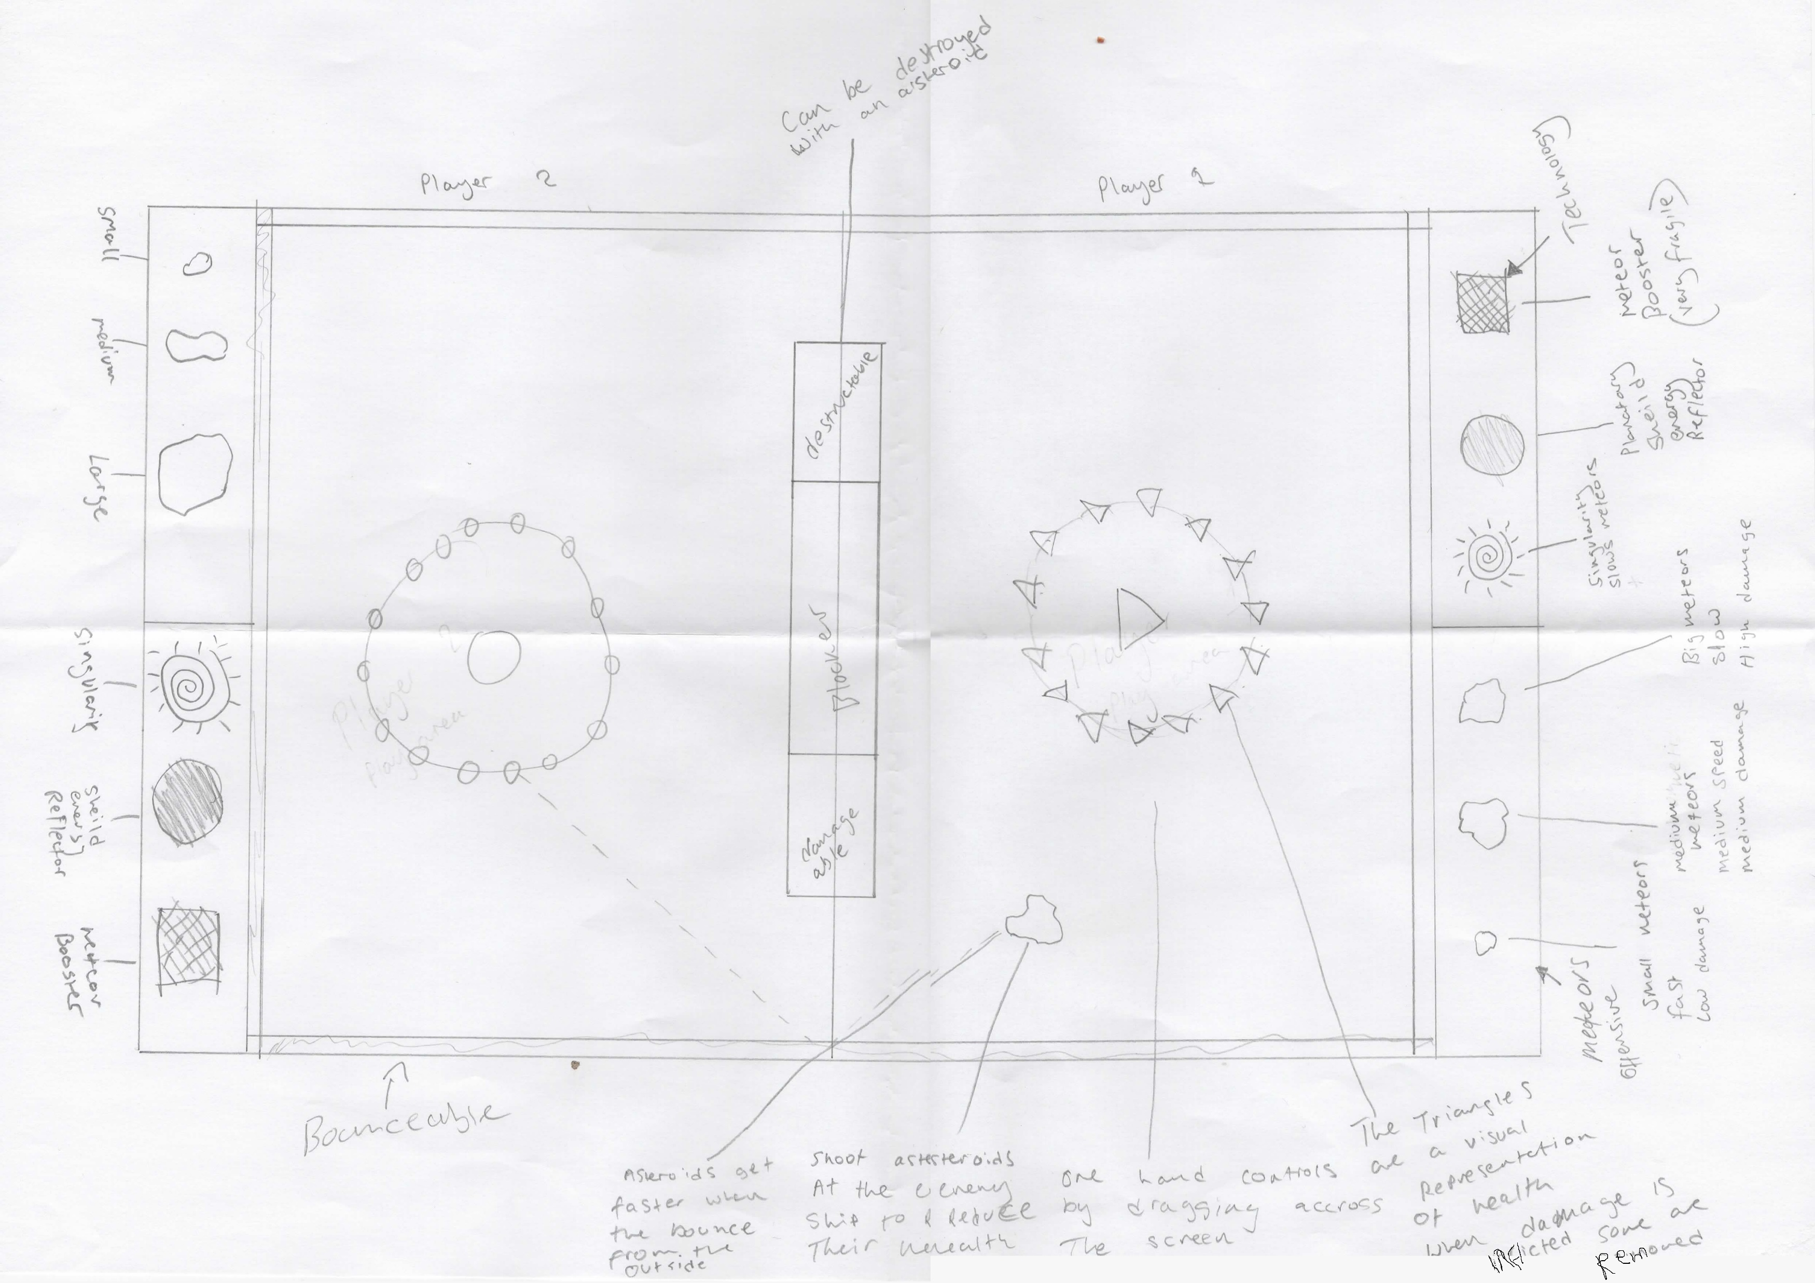
Bringing it all together Elements we want in our Game
Trial and Error.
Simple Controls.
Simultaneous play.
Bouncing/Richochet.

Slide 3
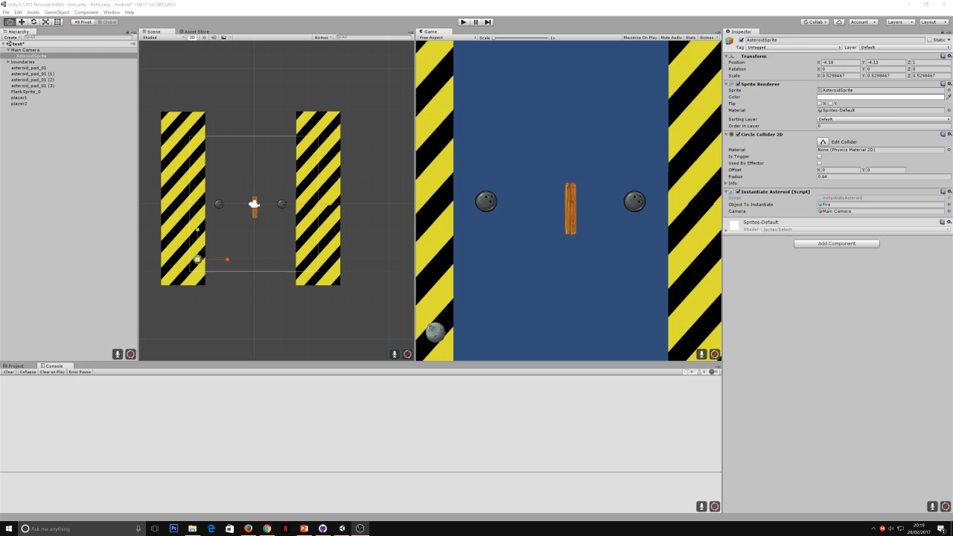
Prototype Two

Slide 4
Prototype Three

Slide 5
Conclusion

Slide 6
Questions?

